Slide 1


ENS DAO Governance Evaluation
Stakeholder Analysis & Retrospective Assessment
Metagov Research Team • February 10, 2026

Slide 2
Today's Overview
Overview of Objectives, Timeline for all Three Phases
Deep Dive into Phase 1
Feedback

Slide 3
Research Team
Co-Lead: Mike Cooper (@MCooperResearch) Co-Lead: Eugene Levanthal (@eleventh19)
DAOstar Researchers
Sam McCarthy
Rashmi Abbigeri
Rohit Malekar

Slide 4
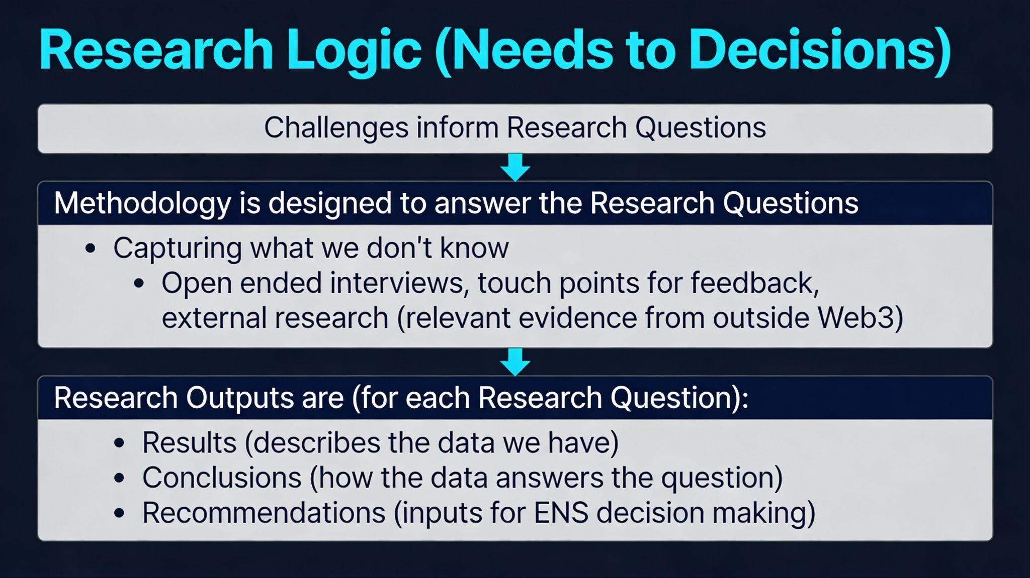

Slide 5
Reported Governance Challenges
Common agreement on challenges and opportunity:
Voting power concentration and representativeness concerns
Low broad-based participation threatening governance legitimacy
Communication fragmentation across stakeholder groups
De facto centralization of decision-making creating process friction
Treasury and institutional liability risk

Slide 6
Primary Research Questions
RQ1: Root Causes
What are the root causes of communication and operational inefficiency within ENS DAO governance, and how are these causes perceived and prioritized differently across stakeholder groups (stewards, delegates, token holders, service providers)?
RQ2: Solutions
What changes—informed by comparative DAO research, organizational theory, and stakeholder input—are most likely to improve ENS DAO coordination and execution effectiveness while maintaining commitment to decentralization and broad stakeholder inclusion?

Slide 7
Three-Phase Methodology*
Ongoing: Biweekly check-ins during regularly scheduled MetaGov calls
Phase 1 (February 2 – March 2) Stakeholder Analysis & Pre-Retro Data Collection
Build evidence-based understanding through interviews, community discussions, and data repository setup
Phase 2 (March 2 – March 23): Comparative DAO Research
Document reforms in 4-6 comparable DAOs, synthesize evidence-graded catalogue of candidate solutions
Phase 3 (March 23 – April 20): Retrospective Assessment and Recommendations
Analyze spending and governance decisions against intended outcomes, identify root causes and patterns
Integrate findings, develop prioritized roadmap, produce final report and community-facing materials

Slide 8
Phase 1 Overview
Phase 1A: Stakeholder Analysis
Data Collection:
20-25 interviews, 2 community discussions (possible), stakeholder mapping, external literature review
Deliverables:
Stakeholder Analysis Report
Phase 1B: Pre-Retro Data
Data Collection:
voting data, governance velocity, financials
Deliverables:
Data Repository prepped for retro assessment

Slide 9
Phase 1B: Pre-Retro Data
Objective
To gather all of the relevant data that needs to be analyzed to understand if the desired outcomes defined in Phase 1 were or were not accomplished as part of conducting the full retro in Phase 3
Output
A shared repository of relevant documents and data sources

Slide 10
Inventory of Public Data Sources (so far)
Treasury
Governance
ENS Wallets (WG treasury monitoring)
SafeNotes (transaction annotations)
WG Spending Reports
Karpatkey Reports (treasury management)
ENS Small Grants
ENS Governance Forum
Snapshot (offchain voting)
Tally (onchain governance)
Agora (proposal tracking)
Dune (ENS DAO Governance dashboard)
votingpower.xyz (delegate overview)
Github (ensdomains governance docs)
Retrospective Data Sources
TG: @samccarthy27

